Slide 1
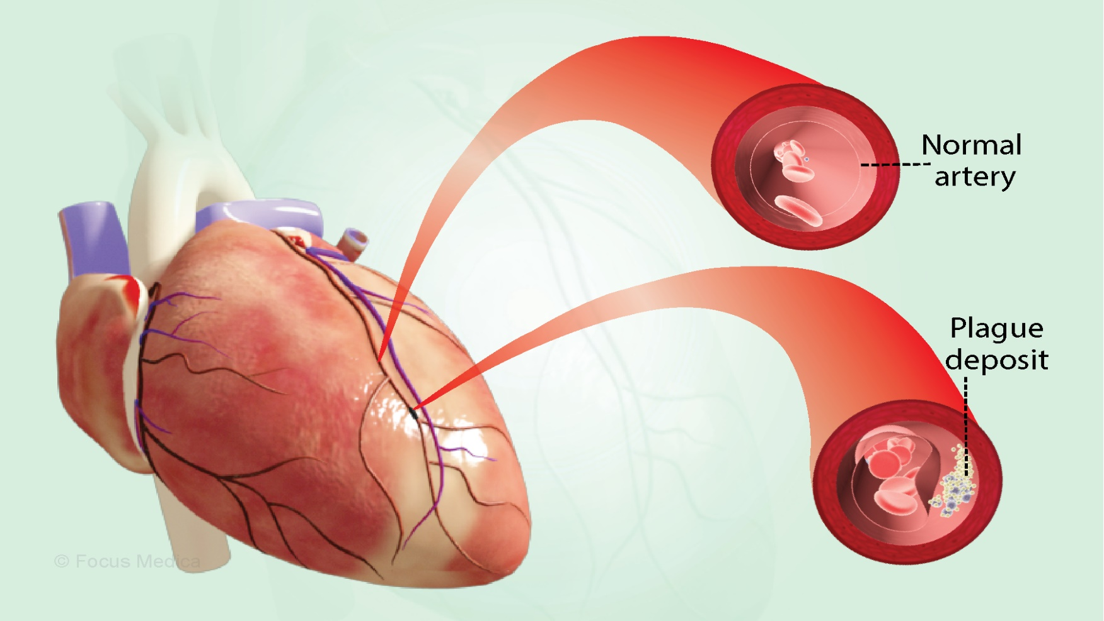
Cardiovascular Pathology Atherosclerosis
November 2024
Notes:
Figure 11 The growing fatty streak eventually forms the lipid core, which becomes isolated by the progressive formation of a fibrous cap. The fibrous cap contains collagen, proteoglycans and activated smooth muscle cells. The sturdier the cap, the less likelihood there is of plaque rupture.
KW: artery, arterial wall, atherogenesis, foam cell, fatty streak, plaque, macrophage, modified LDL, fibrous cap, collagen

Slide 2
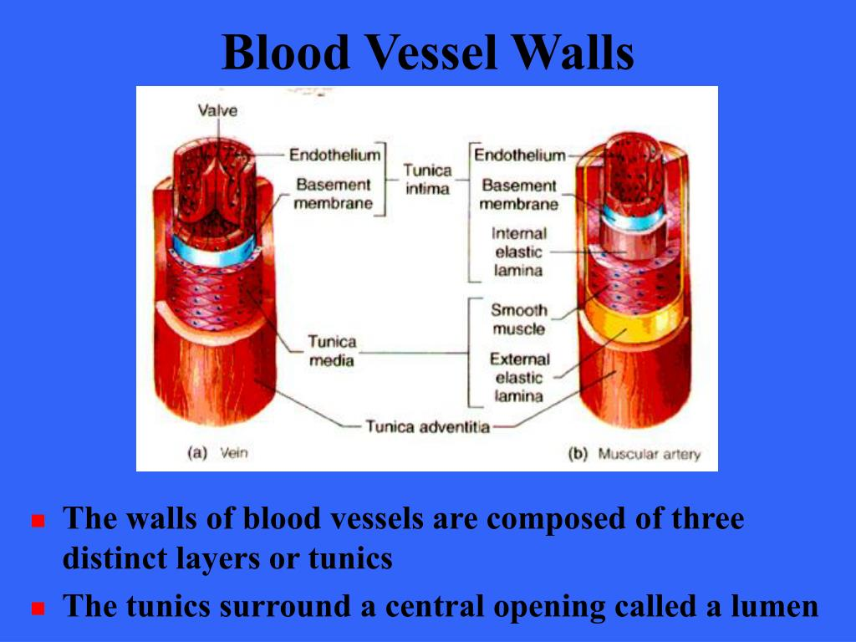

Slide 3

Structural and Functional Properties of Vascular Endothelial Cells
Maintenance of permeability; barrier for molecules, cells, or pathogens
Extracellular matrix production
Elaboration of anticoagulant
Antithrombotic molecules
Elaboration of antiplatelet molecules
Modulation of blood flow

Slide 5
Arteriosclerosis
A generic term that describes thickening and hardening of the arteries; four general patterns:
- Atherosclerosis
- Monckeberg’s medial calcific sclerosis
- Fibromuscular intimal hyperplasia
- Arteriolar sclerosis

Slide 6

Arteriosclerosis
Atherosclerosis Monckeberg’s Fibromuscular Arteriolar sclerosis
Intimal Hyperplasia
Fibrointima Plaques
Aorta, Coronary, Cerebral
Aortic Cerebral
Aneurysm Infarcts
Myocardial
Infarcts
Medial Calcium Deposits
Muscular Arteries
Calcifications of Arteries
In Upper and Lower
Extremities
Inflammation; Mechanical
Injury
Small Vessels
Muscular Arteries
Healed Arteritis
Hyaline Hyperplastic

Slide 7
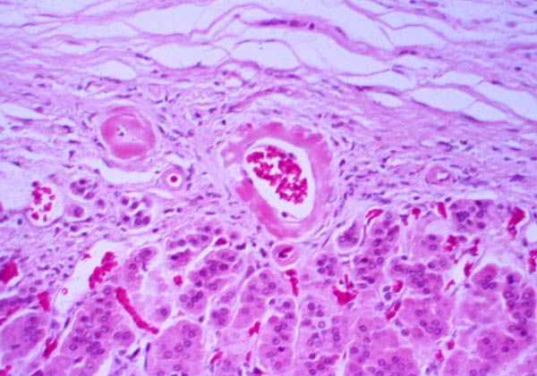

Slide 8
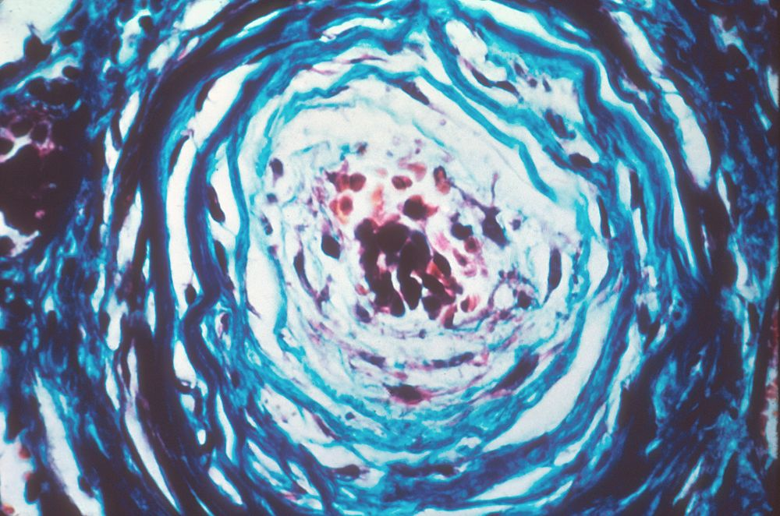

Slide 9
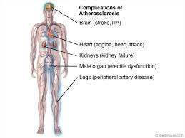

Slide 10
Congenital Vascular Anomalies
Berry aneurysms - A sac-like out pouching in a cerebral blood vessel. Once a berry aneurysm has formed it is likely to rupture, causing a stroke. Thus they are serious medical emergencies, and should be treated as soon as possible.
Arteriovenous fistulas - An arteriovenous fistula is an abnormal connection or passageway between an artery and a vein. It may be congenital, surgically created for hemodialysis treatments, or acquired due to pathologic process, such as trauma or erosion of an arterial aneurysm.
Fibromuscular dysplasia - Fibromuscular dysplasia is a disease that can cause stenosis of arteries in the kidneys, the carotid arteries supplying the brain, and, less commonly, the arteries of the abdomen.

Slide 11
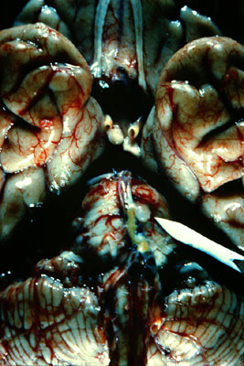
Berry Aneurysm

Slide 12
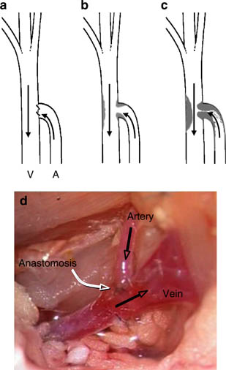
C
Schematic representation of Arteriovenous fistula-associated lesion formation in mice

Slide 13
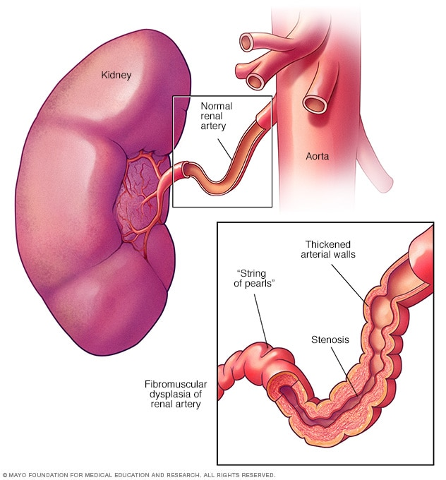

Slide 14
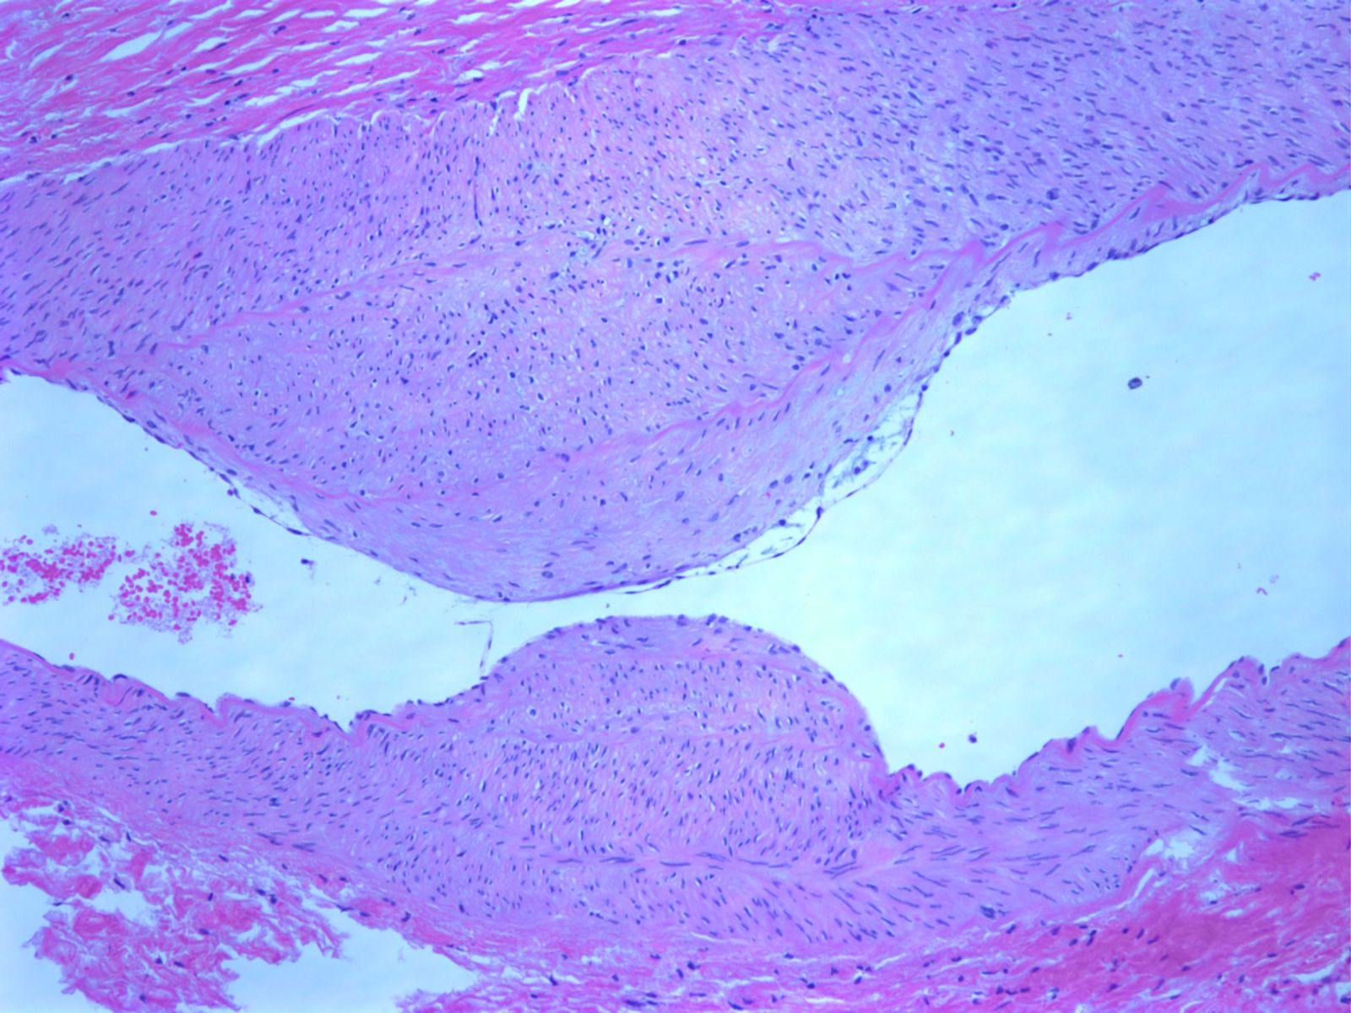
Fibromuscular dysplasia; 25 year old woman with thickened media alternating with thinned media aneurysmal dilatation

Slide 15
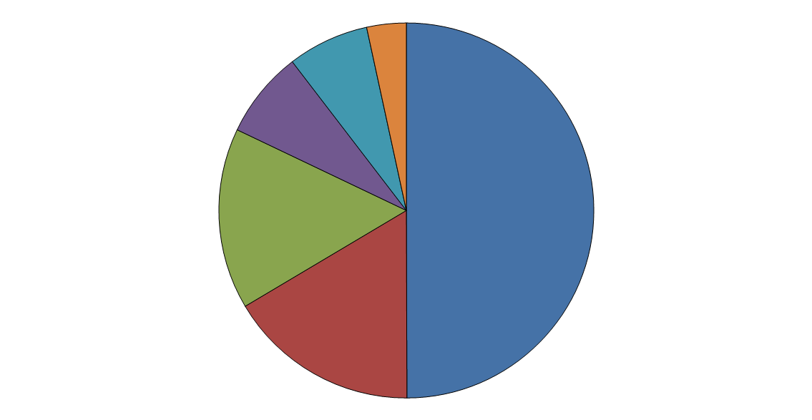
Deaths From Cardiovascular Diseases, Percent by Subgroup, U.S.
Heart Failure
(Underlying)* 7.0%
Diseases of Arteries 3.4%
Hypertensive Diseases
7.5%
Coronary Heart Disease
49.9%
Other Cardiovascular
Diseases 15.6%
Stroke
16.5%
* Heart failure as an underlying cause or otherwise mentioned on the death certificate accounted for 35% (281,437) of
total CVD deaths.
Total deaths = 811,940 (100%), including 3,415 due to congenital CVD defects.
Compiled from Vital Statistics of the United States, NCHS.

Slide 16
Modifiable (potentially controllable) Risk Factors
Hyperlipidemia – most evidence specifically implicates hypercholesterolemia, the
major component of total cholesterol that is associated with increased risk is LDL cholesterol.
Hypertension –(BP ≥140/90 mmHg or on antihypertensive medication); severity as a risk factor increases with age; both systolic and diastolic levels are important in increasing risk; antihypertensive therapy reduces the incidence of atherosclerosis.
Cigarette Smoking - > 1 package/day ↑ death rate from CHD by up to 200%; smoke cessation ↓ risk by ½; nicotine can produce calcification and necrosis of the arterial media.
Diabetes – incidence of MI 2X as high than nondiabetics; 100–fold ↑ risk of AS-induced gangrene; metabolic derangements, mainly hyperglycemia.

Slide 17
Nonmodifiable (Constitutional) Risk Factors
Age – (men ≥45 years; women ≥55 years); death rates from IHD rise with each decade.
Gender – men are more prone to develop AS than women possibly due to estrogen; after menopause incidence in women ↑ .
Family history – familial clustering of risk factors; hereditary genetic derangements in lipoprotein metabolism.
Genetic Abnormalities – incidence in atherosclerosis is increased in individuals with familial hyperlipidemia; other risk factors such as hypertension and diabetes mellitus can also be inherited.

Slide 18
Additional Risk Factors
Homocysteine - reacts with apoB to generate modified LDL species; decrease vitamin B12
Obesity
Personality type
Stress
Postmenopausal estrogen deficiency
Alcohol
Lipoprotein (a)
Low HDL Cholesterol (< 40 mg/dL)
C-Reactive Protein (> 3mg/L = high risk)

Slide 19
C- REACTIVE PROTEIN
Provides a stable plasma biomarker for low-grade systemic inflammation
Produced predominantly in the liver as part of the acute phase response
Expressed in smooth muscle cells within diseased atherosclerotic arteries

Slide 20
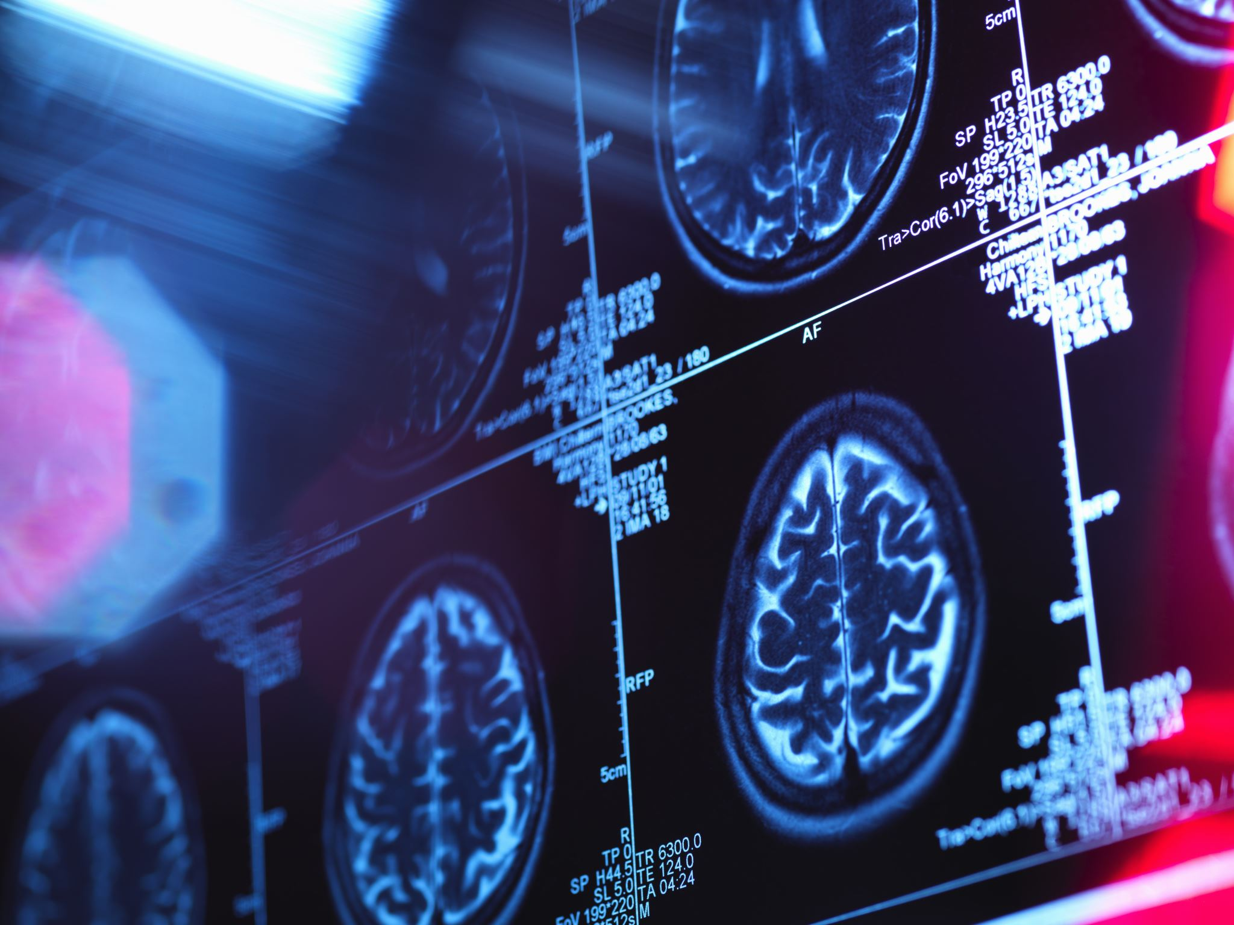
There are also several medical conditions that are not directly related to your heart and blood vessels that may increase your risk for coronary heart disease, such as:
autoimmune and inflammatory diseases, such as Crohn’s disease, ulcerative colitis, psoriasis, lichen planus, pemphigus, histiocytosis, lupus erythematosus, and rheumatoid arthritis
Chronic kidney disease
Diabetes
HIV/AIDS, especially among older adults. Part of the risk might be due to side effects of HIV treatments.
Mental health conditions, including anxiety, depression, and post-traumatic stress disorder (PTSD)
Metabolic syndrome
Overweight and obesity
Sleep disorders, such as sleep apnea or sleep deprivation and deficiency

Slide 21
Treatment of Atherosclerosis
Medicines
Ace inhibitors and beta blockers
Lowers BP (Propranolol)
Antiplatelet or anti-clotting
risk of complications (Plavix)
Calcium channel blockers
Lowers BP (Amlodipine)
Nitrates
Dilates coronaries (nitroglycerin)
Metformin
Controls plaque buildup
Statins
Lowers cholesterol (lovastatin)
Heart-healthy lifestyle
Heart healthy diet
Physical activity
Healthy weight
Manage stress
Quit smoking
Quality sleep

Slide 22
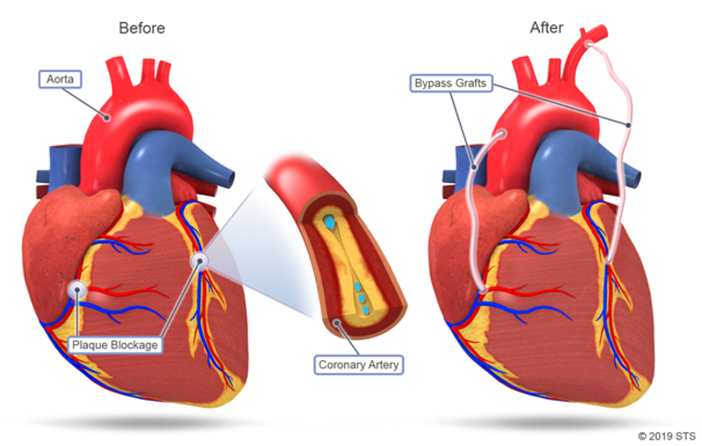
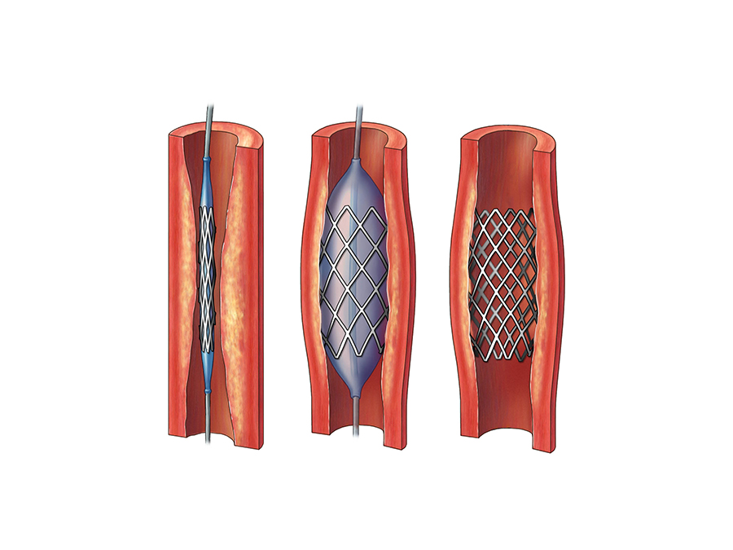
Procedures or Surgeries
Angioplasty
Coronary artery bypass grafting

Slide 23
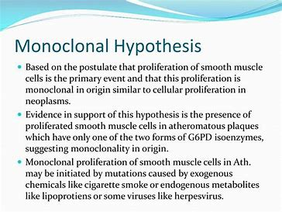

Slide 24
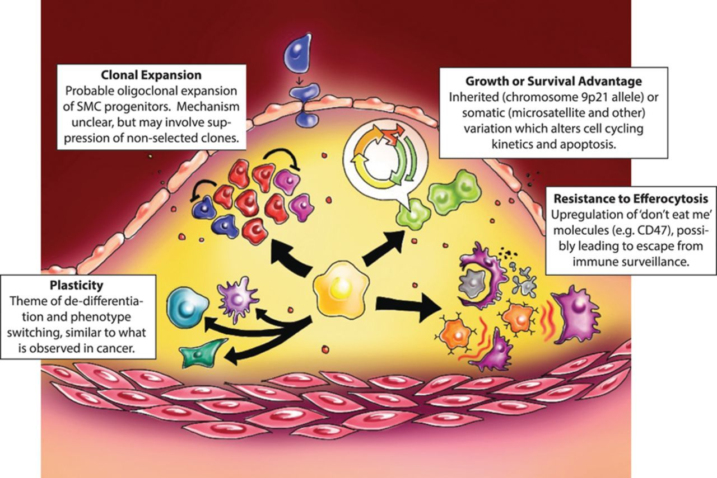
Monoclonal Hypothesis

Slide 25
LIPID INFILTRATION OR INSUDATION HYPOTHESIS
High LDL levels cause high rates of LDL entry into the artery wall.
LDL is taken up by cells in the artery wall.
Cholesterol unloading mechanisms are overloaded resulting in accelerated atherogenesis.

Slide 26
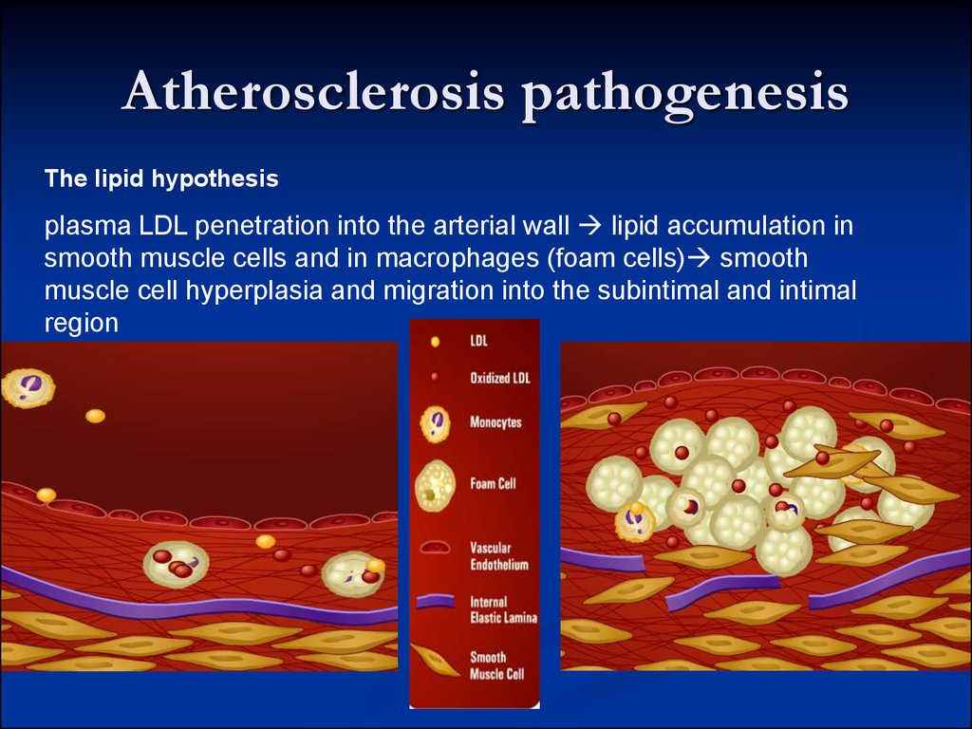

Slide 27
REACTION TO INJURY THEORY
Lesions of atherosclerosis are initiated as a response to an alteration or ‘injury’ to the endothelium.
Injury can result from different types of insults (i.e., mechanical forces, chemical agents, toxins, or viruses).
Severe injuries may lead to platelet adhesion and thrombus formation.
Limited injuries allow the vessel wall to be reconstituted.
Continuous or repeated injuries may lead to lesion progression and narrowing of the arterial lumen.

Slide 28
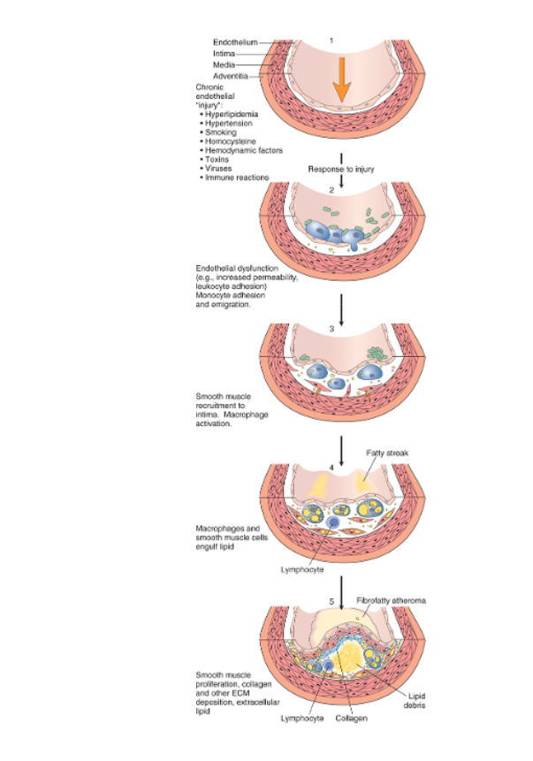
The following are the steps involved in the Response To Injury Hypothesis:
Chronic endothelial injury
Accumulation of lipoproteins
Monocyte adhesion to the endothelium
Platelet adhesion
Factors released
SMC proliferation and ECM production
Lipid accumulation
Calcification

Slide 29
Lipoprotein/Lipid Parameter Function
Chylomicron
Transport Dietary Triglycerides
Moderately associated with premature CHD
VLDL
Carries triglycerides to peripheral cells
High levels may be associated with increased CHD risk
LDL
Carries cholesterol to cells
High levels linked to increased CHD risk
Primary target of cholesterol-reducing therapy
HDL
Removes cholesterol from cells
High HDL considered protective against CHD
HDL >60 mg/dL decreases CHD risk
Lipoprotein(a)
A complex of LDL and apolipoprotein(a)
Prevents LDL from being taken up by the Liver
Elevated Lp(a) is an independent risk factor for premature CHD
Triglycerides
A neutral fat stored in adipose cells
Positively correlated with risk for CHD

Slide 30
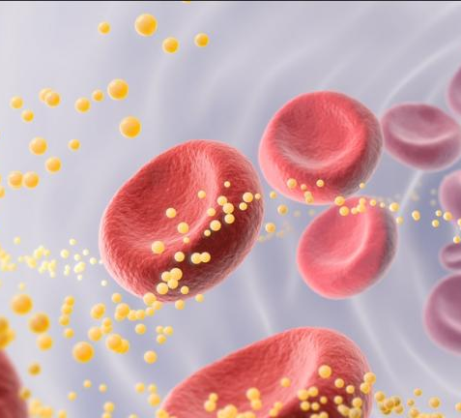
An updated test measures how well "good cholesterol" works

Slide 31
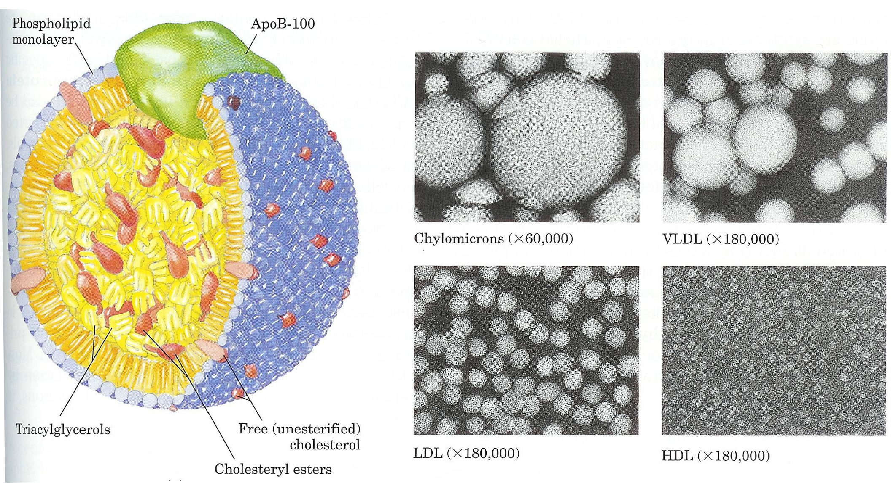
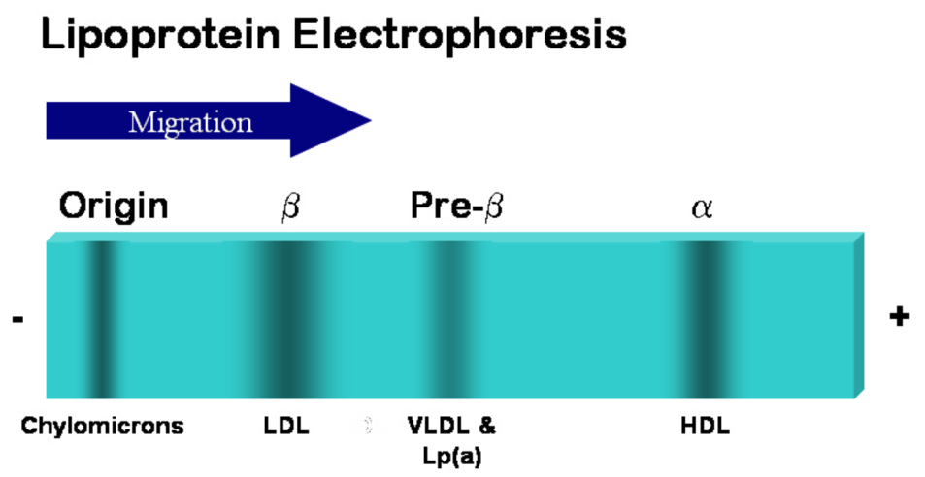

Slide 32
Benefit Beyond LDL Lowering: The Metabolic Syndrome as a Secondary Target of Therapy
General Features of the Metabolic Syndrome
Abdominal obesity
Atherogenic dyslipidemia
Elevated triglycerides
Small LDL particles Low HDL cholesterol
Raised blood pressure
Insulin resistance (± glucose intolerance)
Prothrombotic state
Proinflammatory state

Slide 33
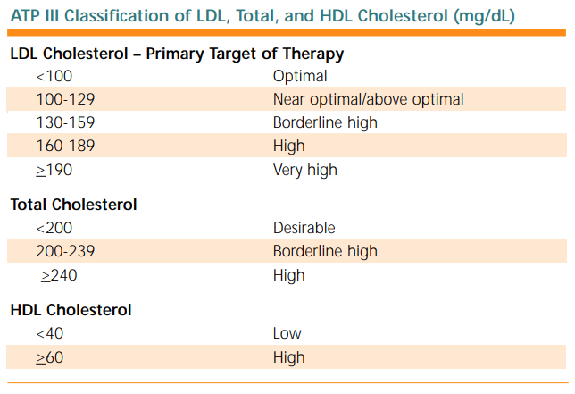

Slide 34
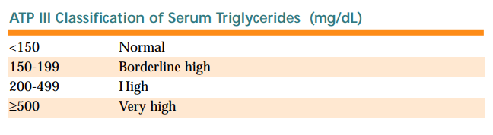

Slide 35
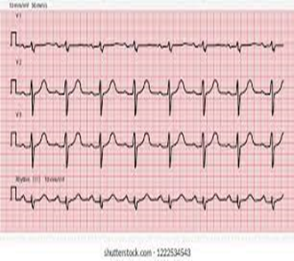
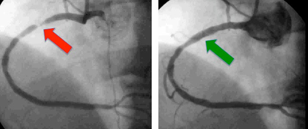
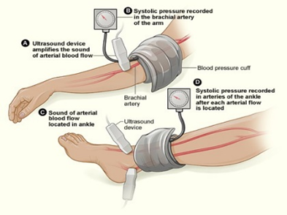
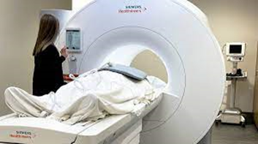
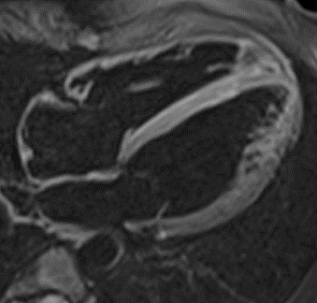
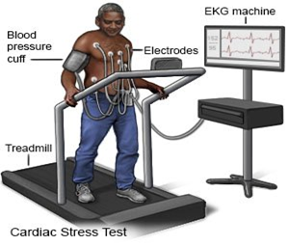
Diagnostic Tests

Slide 36
RISK ASSESSMENT
The following information should be gathered to make a risk assessment:
smokes or not
total and HDL cholesterol levels
blood pressure
diabetes or metabolic syndrome
overweight for age and height
close relatives have or had premature heart disease
With this information, you can place the person into one of three categories: low, intermediate, or high.

Slide 37
APOPROTEIN | ASSOCIATION | COMMENTS
apoA-I | Chylomicron, HDL | Activates LCAT
apoA-II | Chylomicron, HDL | Enhances hepatic lipase
apoB-48 | Chylomicron, HDL | Found in chylomicrons; derived from apo-B-100
apoB-100 | VLDL, IDL, LDL | Binds LDL receptor
apoC-I | Chylomicron remnants, VLDL, LDL and HDL | Activates LCAT
apoC-II | Chylomicron remnants, VLDL, LDL and HDL | Activates lipoprotein lipase
apoC-III | Chylomicron remnants, VLDL, LDL and HDL | Inhibits lipoprotein lipase
apoD | HDL | Cholesterol Ester Exchange Protein
apoE | Chylomicron remnants, VLDL, LDL and HDL | Binds LDL receptor
apo(a) | LDL | Disulfide bonded to B-100

Slide 38
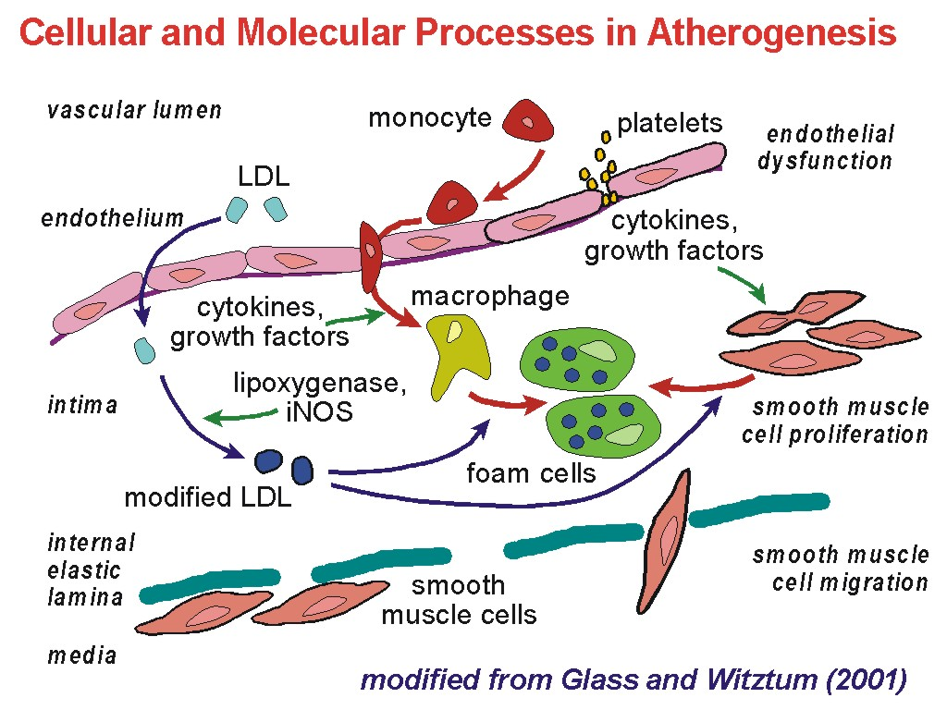

Slide 39
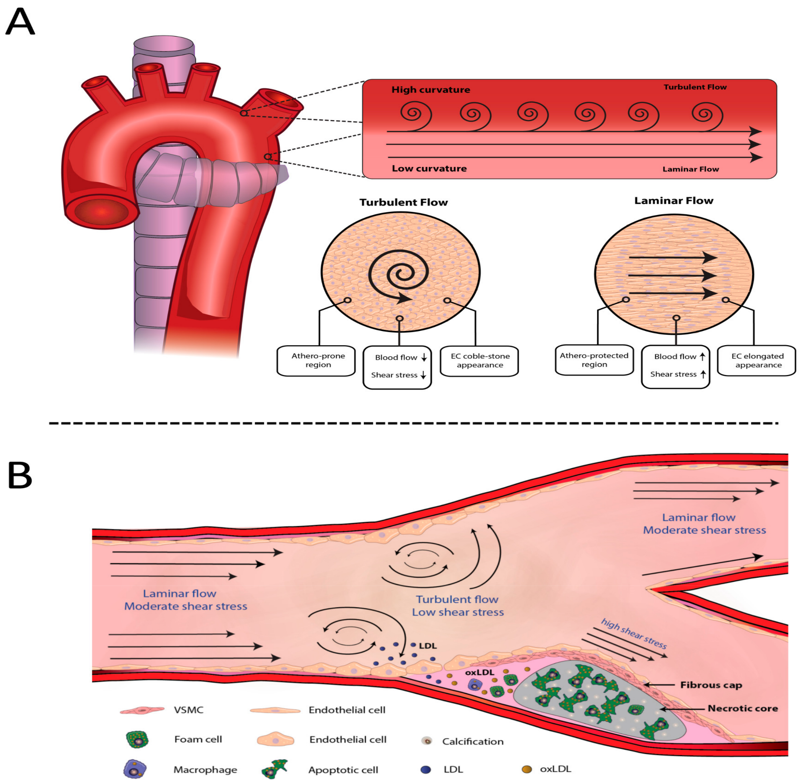

Slide 40
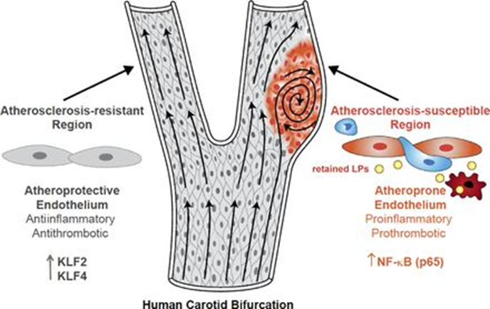
Vascular endothelial cells and the development of early atherosclerotic lesions
Notes:
Vascular endothelial cells and the development of early atherosclerotic lesions. Early lesions of atherosclerosis in the human carotid artery develop in the area of a major curvature (carotid sinus) exposed to low time-average shear stress, a high oscillatory shear index, and steep temporal and spatial gradients. Endothelial cells at this site display an atheroprone phenotype, which promotes a proinflammatory milieu driven by the priming of the NF-κB signaling pathway, which is then perpetuated in response to subendothelial apoB LPs. NF-κB activation promotes the entry of blood-borne monocytes (blue cells) through the junctions of endothelial cells (orange cells) into the intima, and there, monocytes differentiate into macrophages (red cells). In contrast, arterial geometries that are exposed to uniform laminar flow evoke an atheroprotective endothelial cell phenotype driven by the transcriptional integrators KLF2 and KLF4. This atheroprotective endothelial phenotype, together with a decrease in LP retention, promotes an antiinflammatory and antithrombotic environment that affords relative protection from atherosclerotic lesion development.

Slide 41
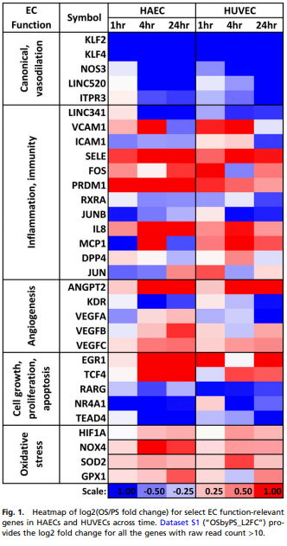

Slide 42
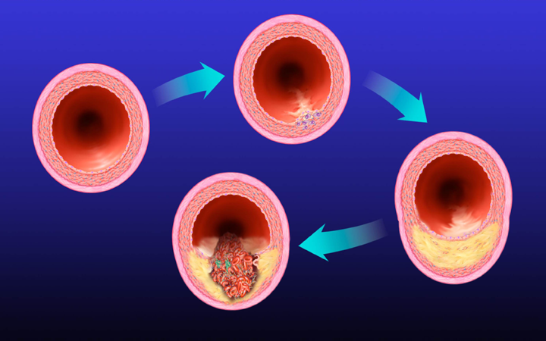
Fatty Streak
Normal
Lipid-rich plaque
Fibrous cap
Lipid core

Slide 43
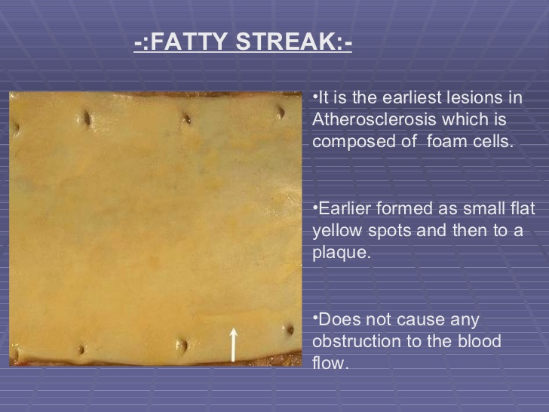

Slide 44
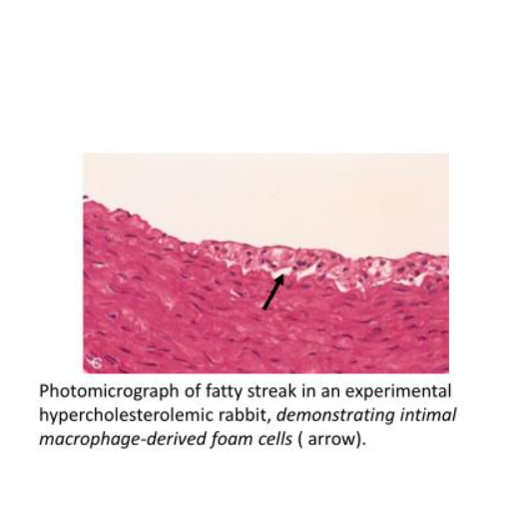

Slide 45
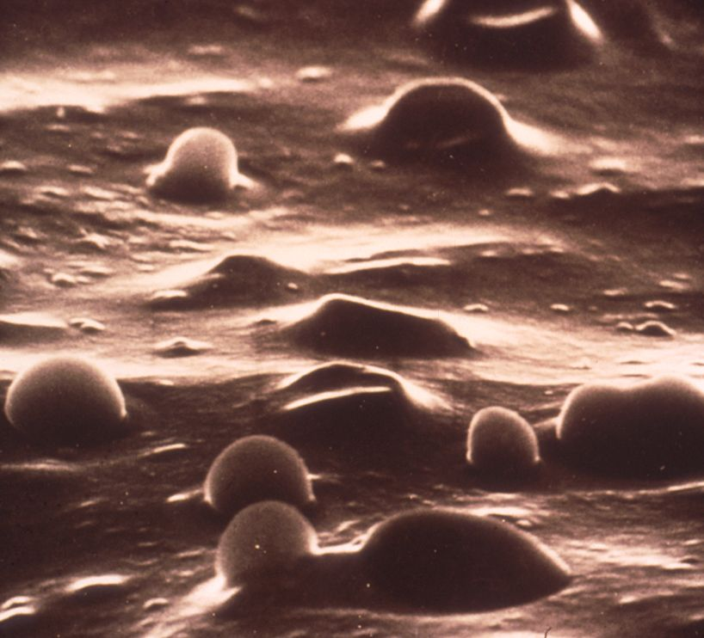

Slide 46
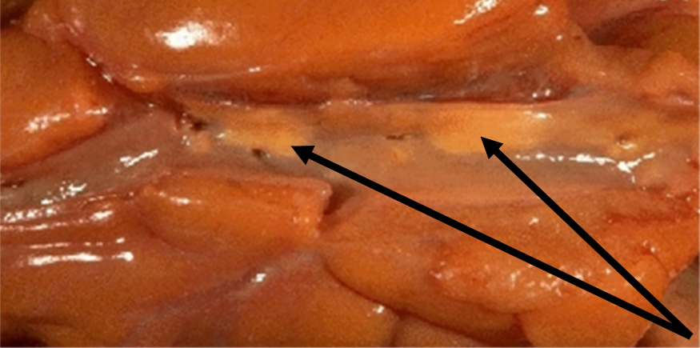
Photograph of the inside of an artery; showing fatty streaks

Slide 47
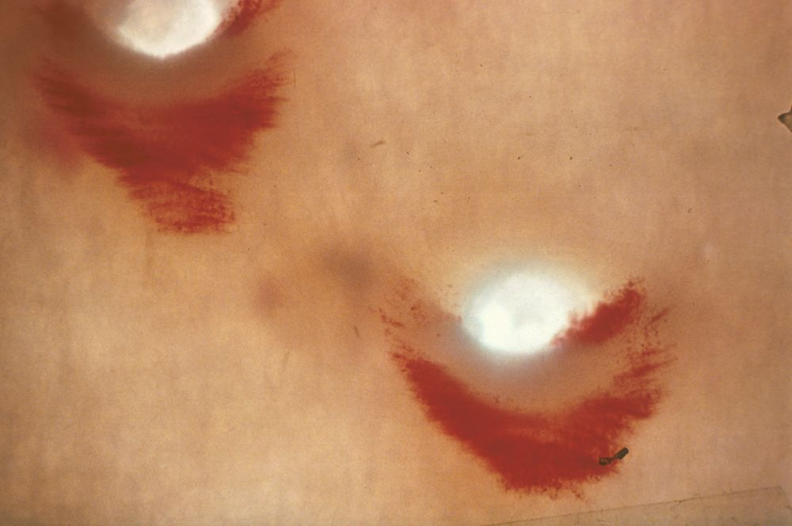

Slide 48
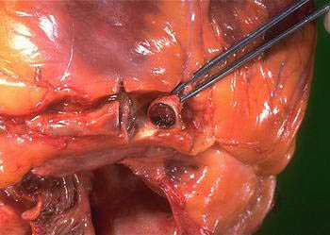

Slide 49
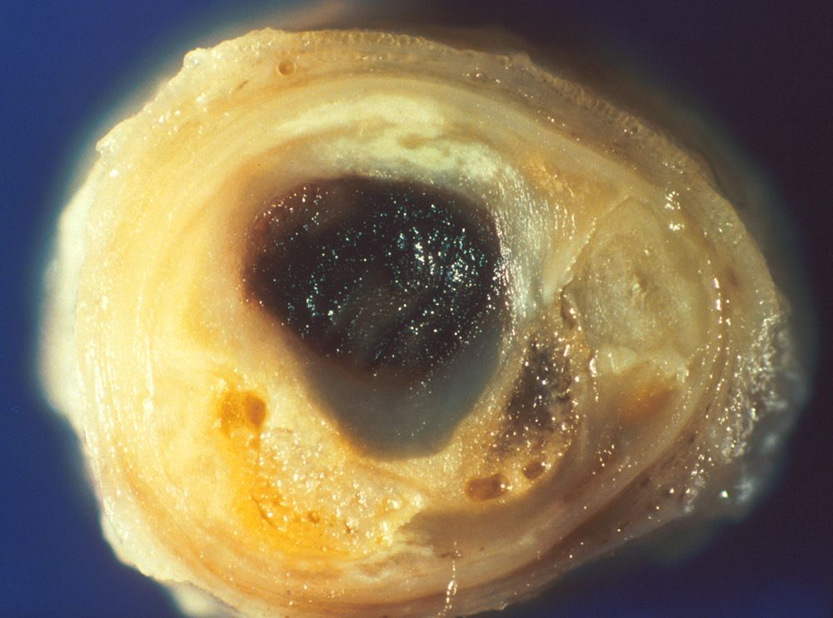

Slide 50
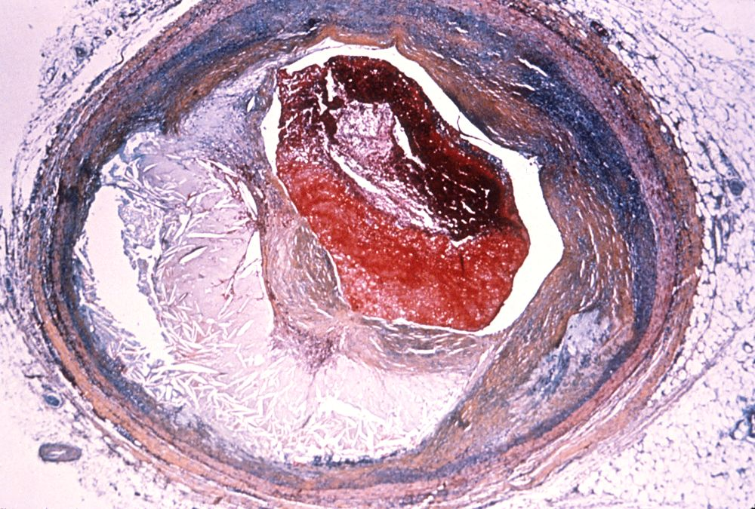

Slide 51
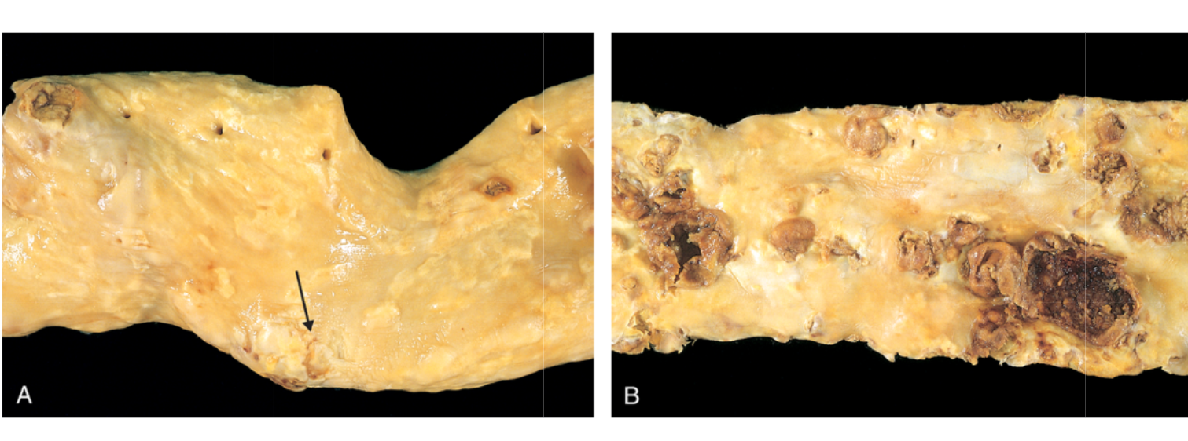

Slide 52
The Hyperlipoproteinemias
Type | Increased Lipoprotein Class | Increased Lipid Class | Genetic Disorders | Primary Defect | Secondary Disorders
1 | Chylomicrons | Triglycerides | Familial lipoprotein lipase deficiency | Deficiency of lipoprotein lipase | SLE
2a | LDL | Cholesterol | Familial hypercholesterolemia (rarely 2b) | Deficiency of LDL receptor | Nephrotic syndrome; hyperthyroidism
2b | LDL and VLDL | Cholesterol and triglycerides | Familial combined hyperlipidemia (also 2a and 4) | Deficiency of LDL receptor | Nephrotic syndrome; diet stress
3 | Remnants (Chylomicrons) and IDL | Triglycerides and Cholesterol | Familial Type 3 hyperlipoproteinemia | Abnormal apoprotein E | Hyperthyroidism
4 | VLDL | Triglycerides | Familial hypertriglyceridemia | Deficiency of lipoprotein lipase | Diabetes mellitus; alcoholism
5 | VLDL and Chylomicrons | Triglycerides and Cholesterol | Familial combined hyperlipidemia | Familial apoprotein CII deficiency | Alcoholism; diabetes; oral contraceptives

Slide 53
Hypolipoproteinemias
Type | Characteristics | Underlying Cause | Other Names
A-α-Lipoproteinemia (Tangeiers Disease) | Hypercholesterolemia normal to high serum TG, reduced serum HDL; appearance of normal HDL having an apo AI/AII ratio of 1:12 instead of 1:3 in normal case; Plasma Ch and PL greatly reduced | Increased metabolism of HDL Apo AI Normal rates of synthesis for both apo AI and AII. | Familial HDL Deficiency, α-lipoprotein deficiency.
A-β-Lipoproteinemia | Lipoproteins that contain apo B (LDL, VLDL, chylomicron) are low; erythrocytes appear thorny and distorted, and there is malabsorption of fat. | Genetic defect where apo B synthesis is shut off. | Acanthocytosia, Bassen-Kornzweig Syndrome
Hypo- β-Lipoproteinemia | LDL levels are low but not absent, HDL are normal and VLDL are mildly lowered. | LDL Levels are 10-20% of normal
Apo A (A-I) use an activator of LCAT

Slide 54
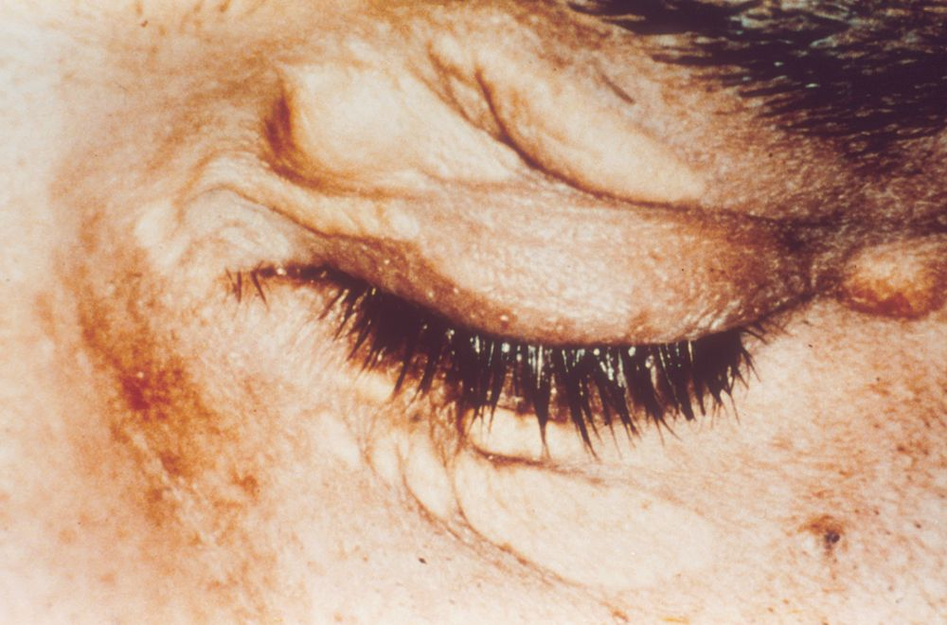

Slide 55
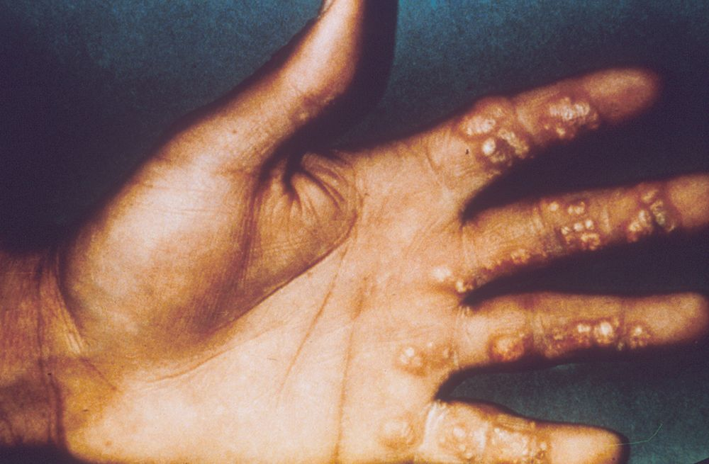

Slide 56
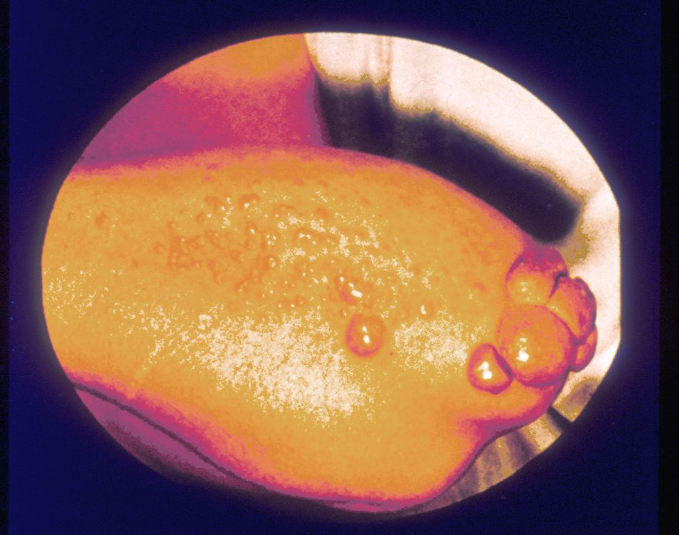

Slide 57
